Slide 1
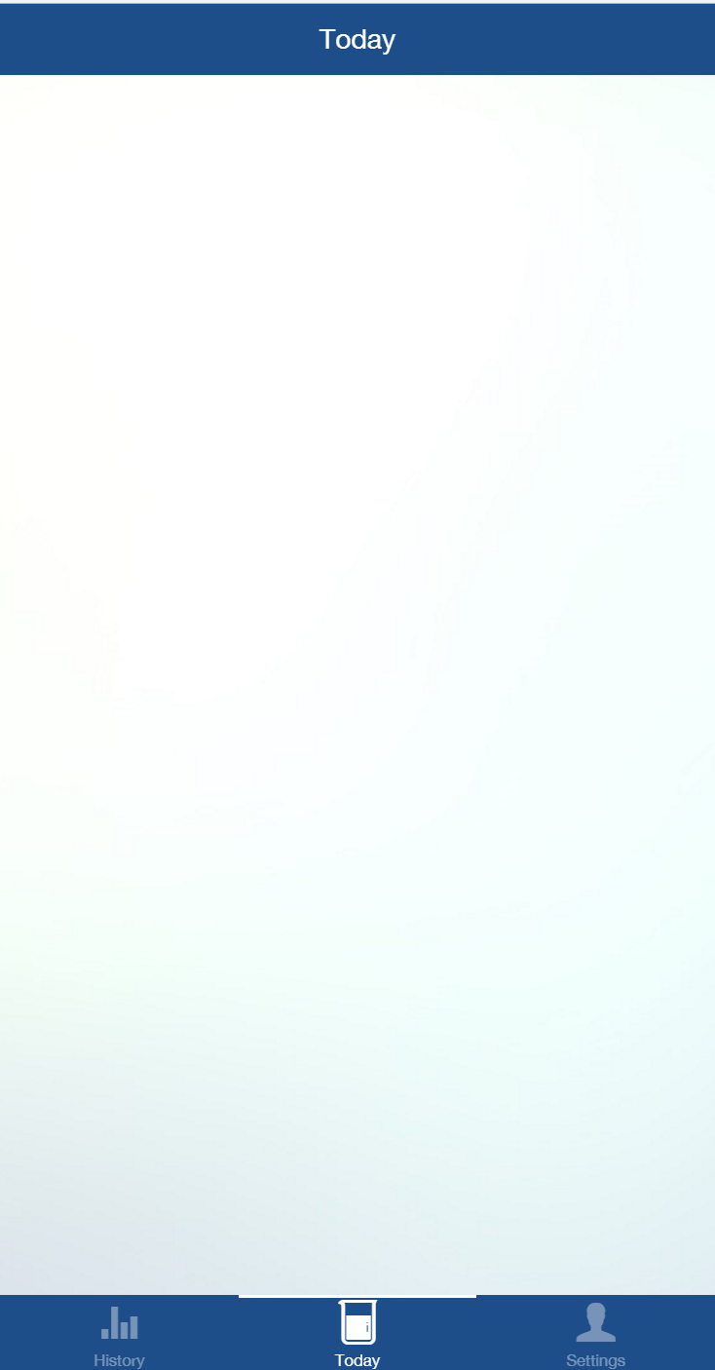

Recommended intake: 5 liters
3.7liters
Last topped up at: 12.34pm

Slide 2


